Slide 1
Research Question
An evaluation of implementing the Traveling Salesman problem utilizing the Google Maps API for route optimization

Slide 2
Research AREAS
Travelling Salesman Problem
Google Maps API

Slide 3
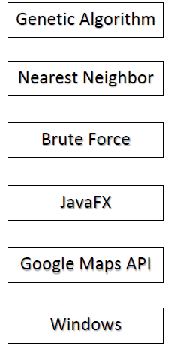
System Architecture Diagram

Slide 4
SPRINTS
1- Integrate Google API and Java
2- Ability to add locations, get coordinates and see current selection
3- Integrate Nearest Neighbor algorithm
4- Develop Genetic Algorithm
5- Complete Genetic Algorithm
6- Implement Brute Force algorithm

Slide 5
DEMO

Slide 6
DIFFICULTIES
Numerous algorithms available
Complexity in implementing a genetic algorithm
Google Maps API usage limit
Generating sample data to test genetic algorithm

Slide 7
CONCLUSION
- The implementation of the TSP in conjunction with Java + Google Maps API services as a success.
- Nearest Neighbor and Brute Force were tested successfully.
- Genetic Algorithm testing restricted due to usage limit on Google side.
- There are possibilities for further development of this project.

Slide 8
Questions?

